Slide 1
Project Presentation of Full Stack Project
On
Online Voting System
Harshit - 2310990684
Ishita – 2310990695
Somya Sharma - 2310991297
Liza Garg - 2310991334
Faculty : Mr Nurul Islam
Department of Computer Science and Engineering, Chitkara University, Punjab

Slide 2
Introduction
An Online Voting System is a web-based application designed to facilitate secure, efficient, and transparent digital elections. It provides a centralized platform where users can register, authenticate, and cast their votes, while administrators can manage elections and candidates.
In today’s digital era, traditional voting systems can be time-consuming and less accessible. This system simplifies the voting process by enabling real-time participation, reducing manual effort, and ensuring accuracy in vote counting.
With role-based access control—Admin and Voter—the system ensures secure authentication and controlled access to functionalities. It enhances transparency, prevents duplicate voting, and enables efficient result management, making the election process faster and more reliable.

Slide 3
Problem Statement
In many scenarios, traditional voting systems face several challenges such as lack of accessibility, time-consuming processes, and risk of human errors. Managing elections manually can lead to inefficiencies and reduced transparency.
There is no centralized system to:
Conduct elections in a secure and efficient manner
Ensure fair and transparent voting
Prevent duplicate or unauthorized voting
Manage candidates and election data effectively
This often results in delays, inaccuracies in vote counting, limited accessibility, and lack of trust in the system.
Therefore, there is a need for an Online Voting System that provides a secure, reliable, and scalable platform to manage elections digitally, ensuring transparency, accuracy, and ease of participation.

Slide 4
Benefits
Secure Voting System Ensures safe and reliable voting using authentication and encryption mechanisms
Centralized Management Provides a single platform to manage elections, candidates, and users efficiently
Clear Role-Based Access Defines roles such as Admin and Voter to ensure controlled and secure operations
Real-Time Voting & Results Allows instant vote casting and quick result calculation
Prevention of Duplicate Voting Ensures that each user can vote only once using validation mechanisms
Enhanced Transparency Maintains accurate records of votes and results, improving trust in the system
Easy Accessibility Users can participate in elections from anywhere through a digital platform
Efficient Election Management Admins can create, manage, start, and end elections smoothly

Slide 5
System Modules
• User Management Module Handles user registration, login, and role management
• Authentication Module
Manages secure login using JWT and password encryption
• Election Management Module Allows admin to create, start, and end elections
• Candidate Management Module Enables adding, viewing, and deleting candidates with image upload
• Voting Module Allows users to cast votes securely with one vote per user restriction
• Result Management Module Calculates total votes and determines the winner
User Roles
• Admin Manages elections and candidates Controls system operations Has full access to all functionalities
• Voter Registers and logs into the system Views elections and candidates Casts vote securely (only once)

Slide 6
Key Features and Functionality
User Registration & Authentication Users can securely register and log in using JWT-based authentication
Election Creation & Management Admin can create, start, and end elections efficiently
Candidate Management Admins can add, view, and delete candidates along with their details and images
Secure Voting System Users can cast their vote in an election with proper validation
One User One Vote Ensures that each user can vote only once per election
Result Calculation Votes are counted automatically and results are generated
Image Upload Support Candidate images are uploaded using Multer and stored on Cloudinary
Role-Based Access Control Different permissions for Admin and Voter ensure system security

Slide 7
Technical Details
Backend Framework Built using Node.js and Express.js to develop scalable RESTful APIs
Architecture Design Follows a modular architecture(divided into different modules)for clean and maintainable code
Database & ORM Uses MySQL with Sequelize ORM for managing relational data and associations
Authentication Mechanism Implements JWT-based authentication for secure and stateless user sessions
Authorization Control Role-based access control (Admin & Voter) using middleware
Middleware Usage Custom middleware for authentication, role verification, vote restriction, and file handling
File Upload System Integrated Multer for file handling and Cloudinary for cloud-based image storage
API Design RESTful APIs for handling operations like authentication, elections, candidates, voting, and results
Testing & Debugging APIs tested using HTTP client tools (REST Client/Postman) for validation and debugging

Slide 8
1. Users Table (Stores user information) Fields: id – Primary key name – User name email – Unique email password –Hashed password role – (admin, voter) is_verified – Verification status 👉 Used for authentication and role-based access 2. Elections Table (Stores election details) Fields: id – Primary key title – Election name description – Details about election start_time – Start time end_time – End time 👉 One election can have multiple candidates
Tables Overview

Slide 9
3. Candidates Table (Stores candidate details) Fields: id – Primary key name – Candidate name party – Party name photo – Image URL (Cloudinary) election_id – Linked to election 👉 Each candidate belongs to one election 4. Votes Table (Stores voting records) Fields: id – Primary key voter_id – User who voted candidate_id – Selected candidate election_id – Related election 👉 Ensures one vote per user per election

Slide 10
5. Results Table (Stores computed results) Fields: id – Primary key election_id – Related election candidate_id – Candidate total_votes – Vote count 👉 Used to determine winner of election

Slide 11
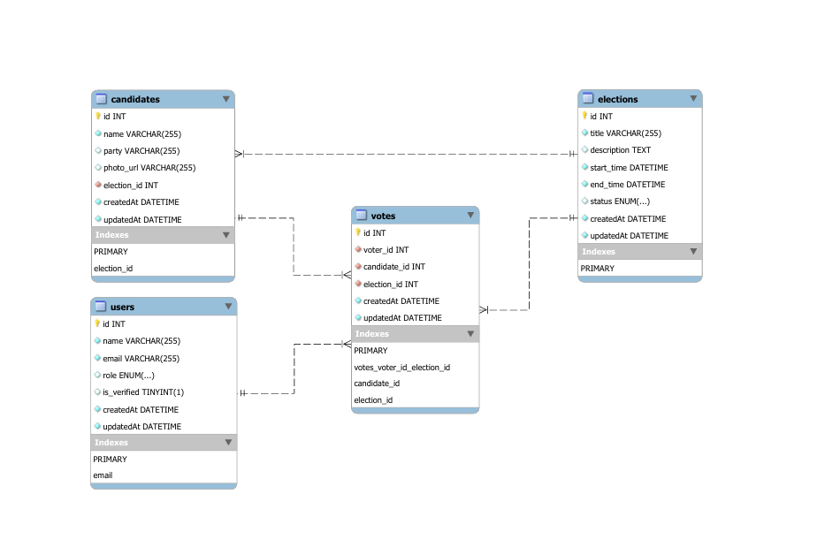

Slide 12
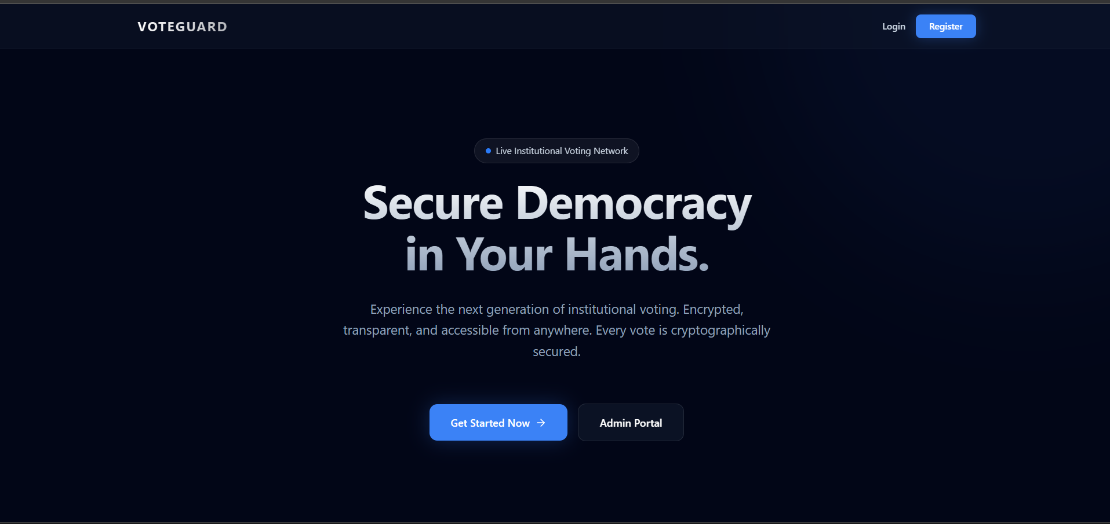

Slide 13
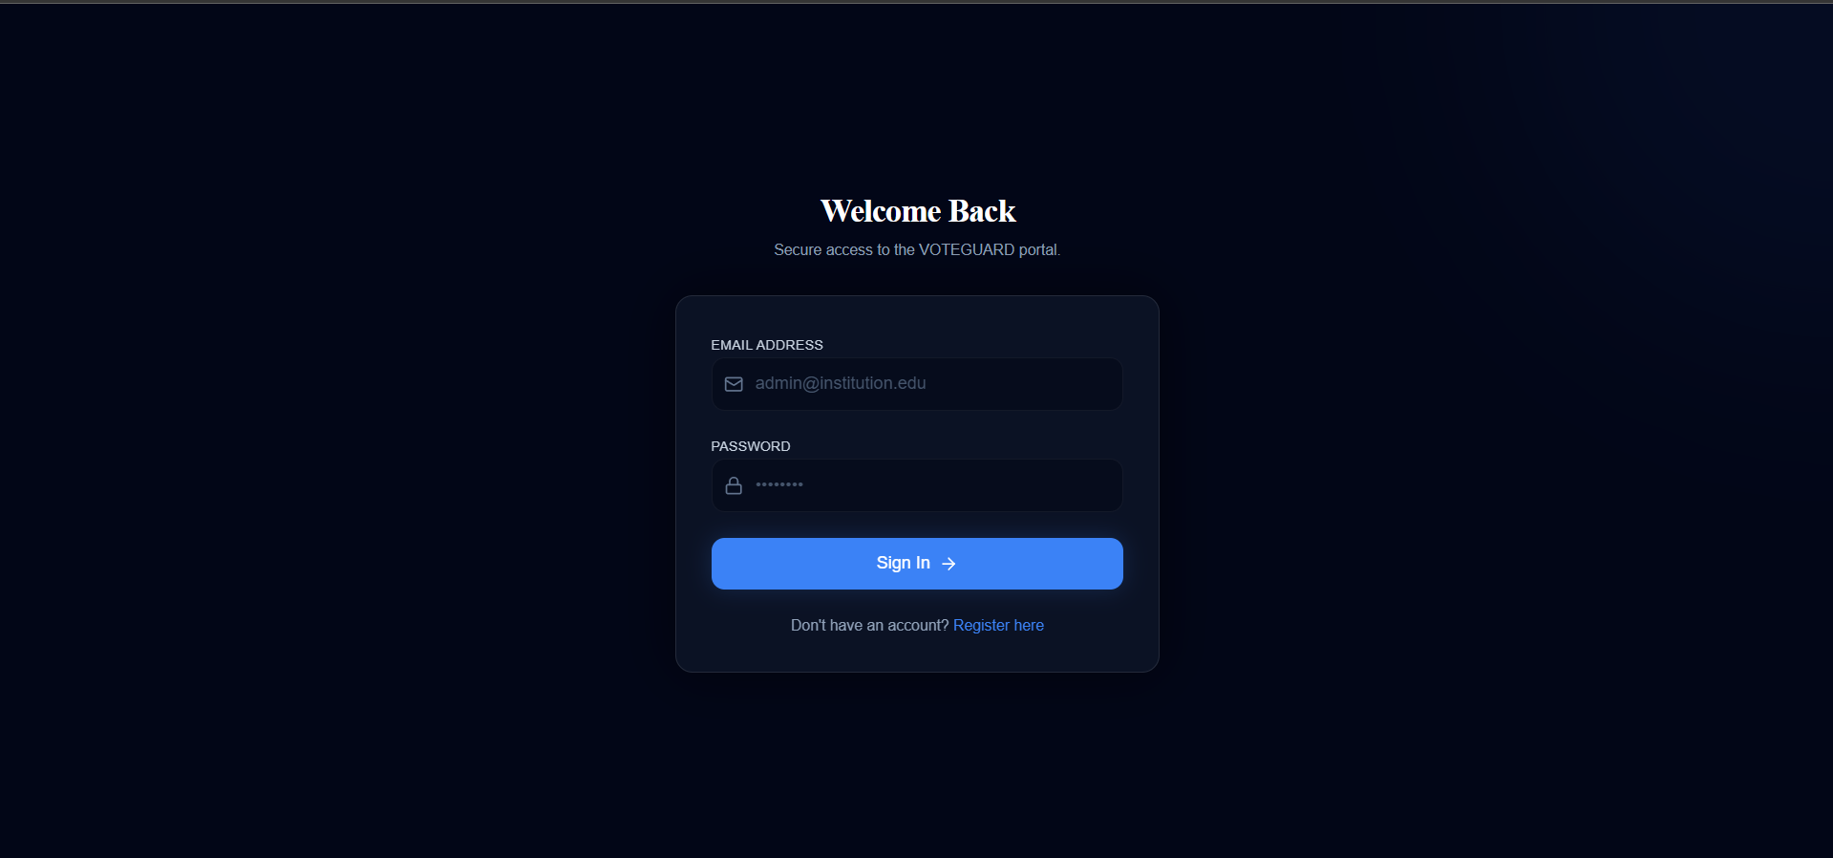

Slide 14
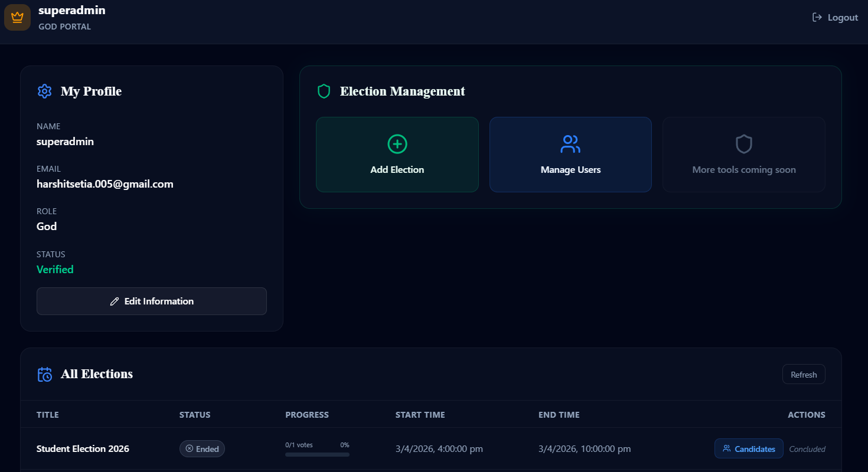

Slide 15
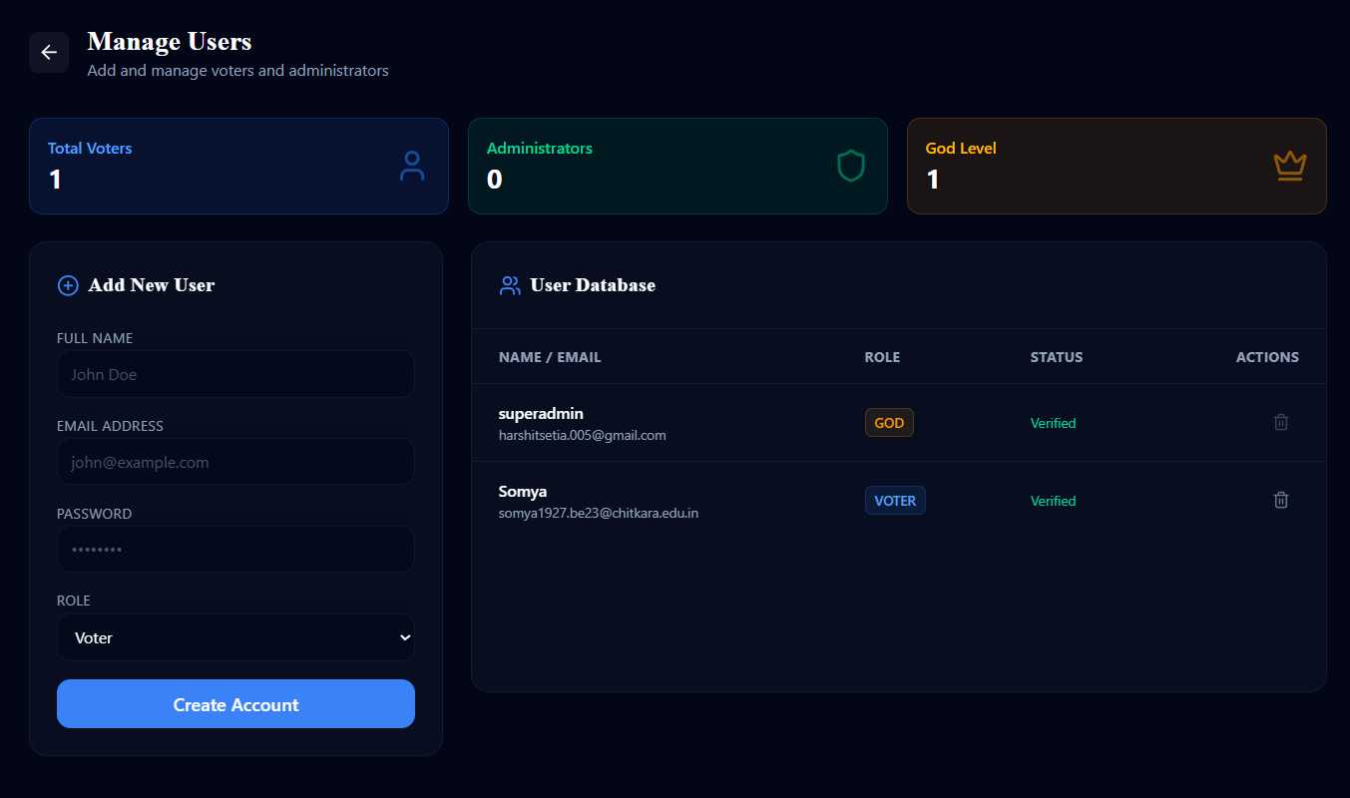

Slide 16
Thank You

